Slide 1



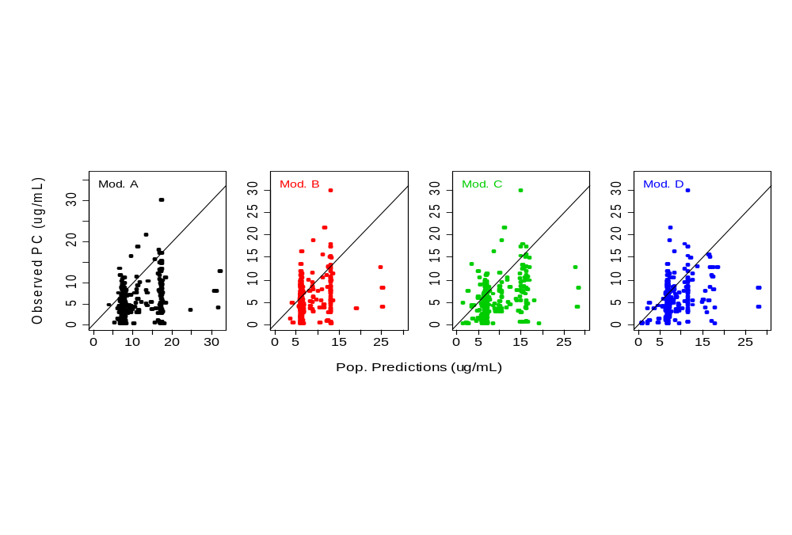
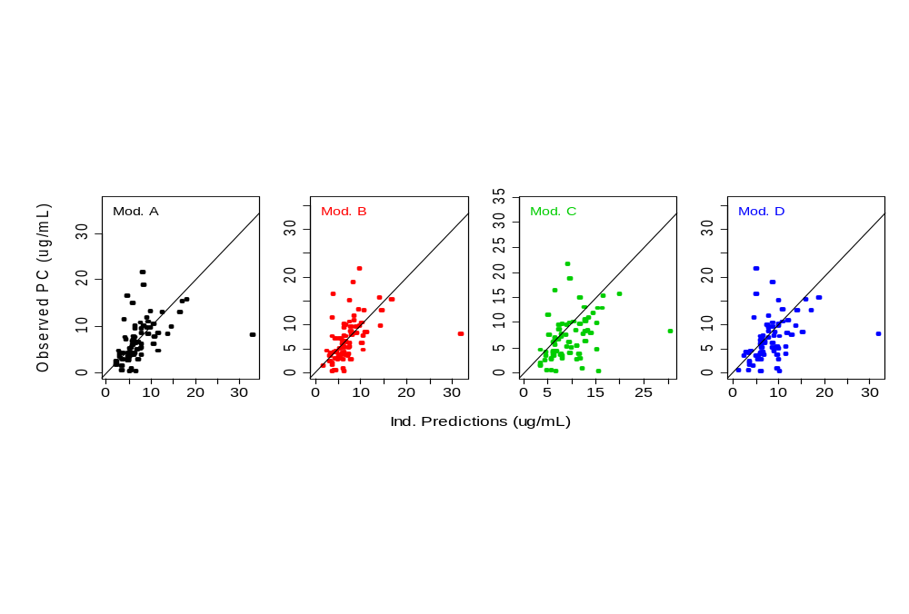
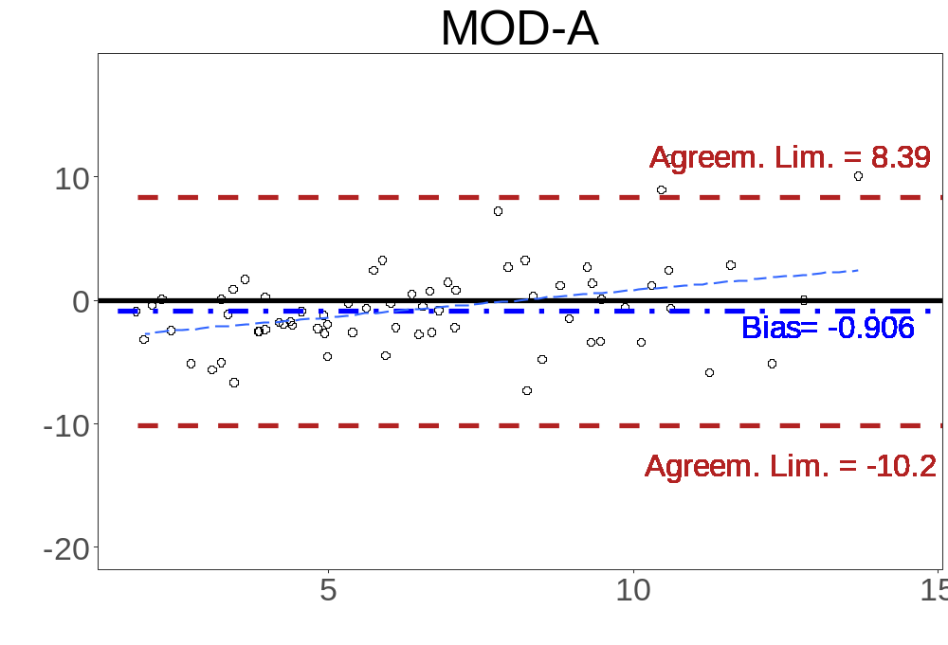
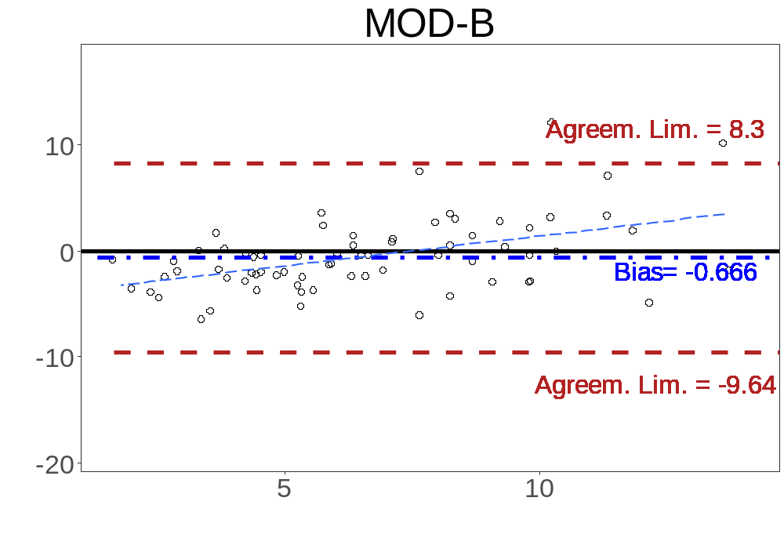
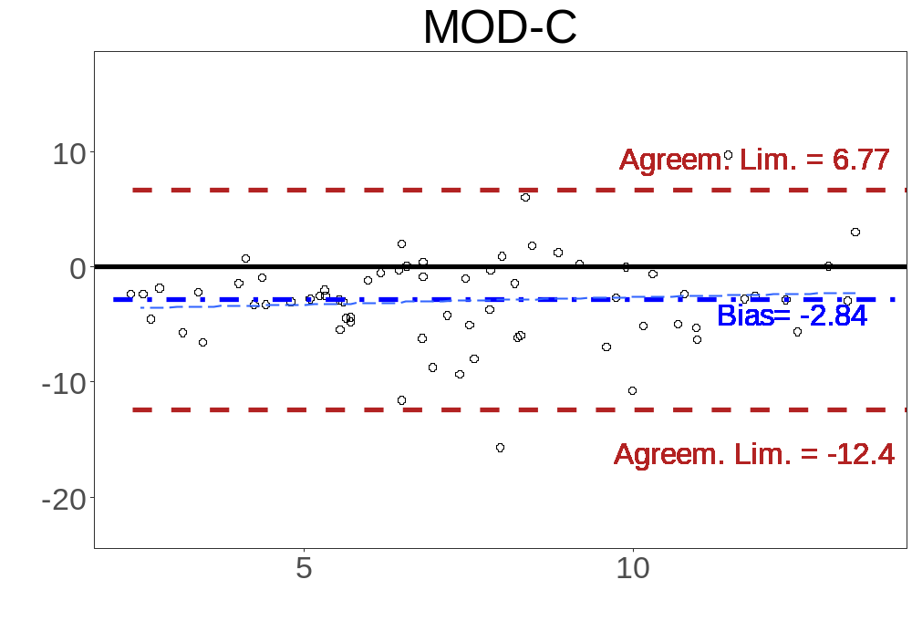
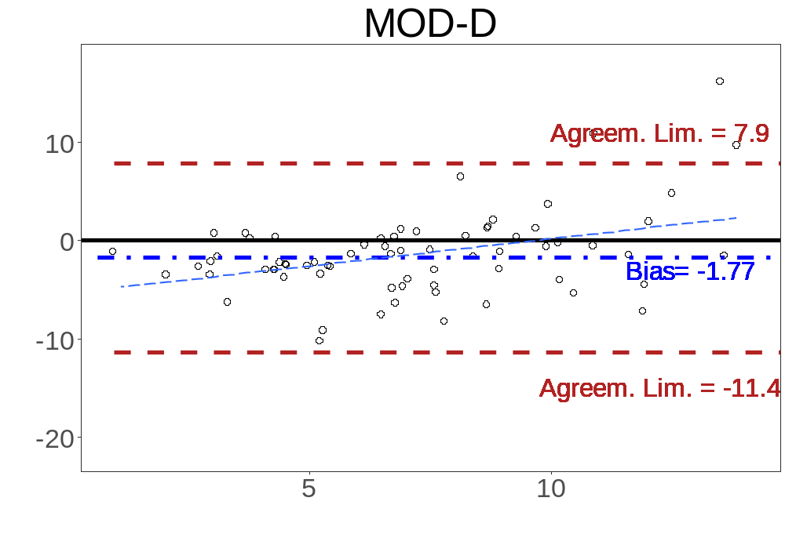
Evaluation of the predictive performance and the model adequacy of four population pharmacokinetic models of adalimumab in patients with inflammatory bowel disease
S. Marquez-Megías¹, A Ramón-López^{1,2}, P Más-Serrano^{1,2,3}, M Díaz-González³, R Nalda-Molina^{1,2}
¹Miguel Hernández University, Department of Engineering, Division of Pharmacy and Pharmaceutics, School of Pharmacy, San Juan de Alicante, Alicante, Spain
² Alicante Institute for Health and Biomedical Research (ISABIAL-FISABIO Foundation), Alicante, Spain
³General Universitary Hospital of Alicante, Pharmacy Department, Clinical Pharmacokinetics Unit, Alicante, Spain.
Introduction and Objectives
Table 1. Baseline demographic characteristics of the 55 patients included in the study.
Adalimumab is an anti-TNF-α recombinant human monoclonal antibody, that has been approved as a therapeutic agent for the inflammatory bowel disease. The treatment with biological drugs can be benefited by the therapeutic drug monitoring (TDM), by calculating the Empirical Bayesian Estimates (EBEs) of the PK parameters. However, there are several Population Pharmacokinetic models (PopPKmod) in literature. A proper evaluation of these models in the target population should be performed before implanted in a clinical routine.
N | 55 |  | Anti-Monoclonal Antibody (%yes) | 4.3%
Age (years) | 44.9 (19-69) |  | PCR (mg/L) | 6.0 (0.1-74)
Albumin (mg/dL) | 3.7 (2.1-4.8) |  | Sex (%woman) | 46,8%
Fecal Calprotectin (mg/kg) | 726.2 (15-3405) |  | Immunosuppressant co-treatment (%yes) | 36.2%
Weight (kg) | 67.6 (38.5-85)
Objective: To evaluate the adequacy and the predictive performance of four PopPKmod of adalimumab in adult patients diagnosed with inflammatory bowel disease.
Table 2. Bias and precision (95% CI) of the model adequacy (Scenario 1) and Predictive Performance (scenario 2) for the four PopPKmod evaluated.
Methods
 | Scenario 1 |  | Scenario 2
 | Bias | Precision | Bias | Precision
Mod-A | -5.26 (-5.95 : -4.57) | 7.61 (6.8 : 8.42) | -0.906 (-1.99 : 0.175) | 4.80 (2.97 : 6.63)
Mod-B | -2.88 (-3.47 : -2.29) | 5.52 (4.88 : 6.16) | -0.666 (-1.71 : 0.376) | 4.59 (2.83 : 6.35)
Mod-C | -3.71 (-4.34 : -3.01) | 6.26 (5.52 : 7.00) | -2.84 (-3.95 : -1.72) | 5.63 (4.22 : 7.04)
Mod-D | -3.06 (-3.66 : -2.46) | 5.67 (4.92 : 6.41) | -1.77 (-2.89 : -0.643) | 5.20 (3.56 : 6.85)
Patients and PopPK models
A retrospective observational study was performed in the General Universitary Hospital of Alicante, with the following inclusion criteria: Adult patients with ulcerative colitis or Crohn’s disease treated with adalimumab, with at least two trough plasma concentration (PC_{T}) between 2014 and 2018.
Four different PopPKmod were evaluated: FDA, 2008 (Mod-A), Ternant et al, 2015 (Mod-B), Sharma et al, 2015 (Mod-C) and Berends et al, 2018 (Mod-D). The models were implemented in NONMEM® v7.3.
Scenarios
The individual and population predictions of adalimumab concentrations were estimated from the four PopPKmod, by calculating the EBEs of the individual pharmacokinetic parameters. Two different scenarios were considered from the dataset to evaluate the model adequacy and predictive performance;
Scenario 1: To evaluate the model adequacy, all PC_{T} were included, and their population predictions were compared with the observed PC_{T}
Scenario 2: To assess the predictive performance, only the first PC_{T} of each patient were used to estimate the EBEs. The PC_{T} that were left out were evaluated with the individual prediction calculated by the EBEs.
Statistics
To validate the four PopPKmod, the bias and precision of the PC_{T} predictions were estimated by calculating the mean predictive error (MPE) and the mean square predictive error (MSPE), respectively. In both cases, the closest to zero, the most accurate and precise, respectively. Bland-Altman analysis were also performed to calculate the 95% agreement limits between individual predictions and observations.
Scenario 1
Scenario 2
Results
Figure 1. Observations vs. Predictions plots in Scenario 1 (model Adequacy) and Scenario 2 (Predictive performance)
The dataset comprised 55 patients and 129 PC_{T}. The mean values (95% CI) of baseline demographic characteristics are displayed in Table 1.
The bias and precision for the model adequacy and predictive performance were displayed in Table 2. The model that performed better in term of bias and precision, in both scenarios, were MOD-B.
In the same way, the model that obtained a narrower agreement limits in the Blandman-Altman analysis (Figure 2) was MOD-B.
Conclusions
Ind. Predictions – Observed PC
The model adequacy analysis and the evaluation of the predictive performance of the four pharmacokinetic models found in literature showed that the model of Ternant D, et al performed better than the other 3.
Therefore, this model would be the preferred to be used in the clinical routine for the dose individualization of Adalimumab for patients with inflammatory disease, in the General Universitary Hospital of Alicante.
Mean of Ind. Prediction and Observed PC
Figure 2. Bland-Altman analysis for the Individual predictions compared with Observed Concentrations.
References
[1] Food and Drug Administration (FDA). HUMIRA: Clinical pharmacology and biopharmaceutics review(s). FDA. 2008.
[2] Ternant D, et al. Pharmacokinetics of adalimumab in Crohn's disease. Eur J Clin Pharmacol. 2015;71(9):1155-7.
[3] Sharma S, et al. Pharmacokinetics and exposure-efficacy relationship of adalimumab in pediatric patients with moderate to severe Crohn's disease: results from a randomized, multicenter, phase-3 study. Inflamm Bowel Dis. 2015;21(4):783-92.
[4] Berends SE. Strik AS, Van Selm JC, Löwenberg M, Ponsioen CY, DʼHaens GR, et al. Explaining Interpatient Variability in Adalimumab Pharmacokinetics in Patients With Crohn's Disease. Ther Drug Monit. 2018;40(2):202-11.

